Slide 1
Final Challenge
Autonomous driving challenge

Slide 2

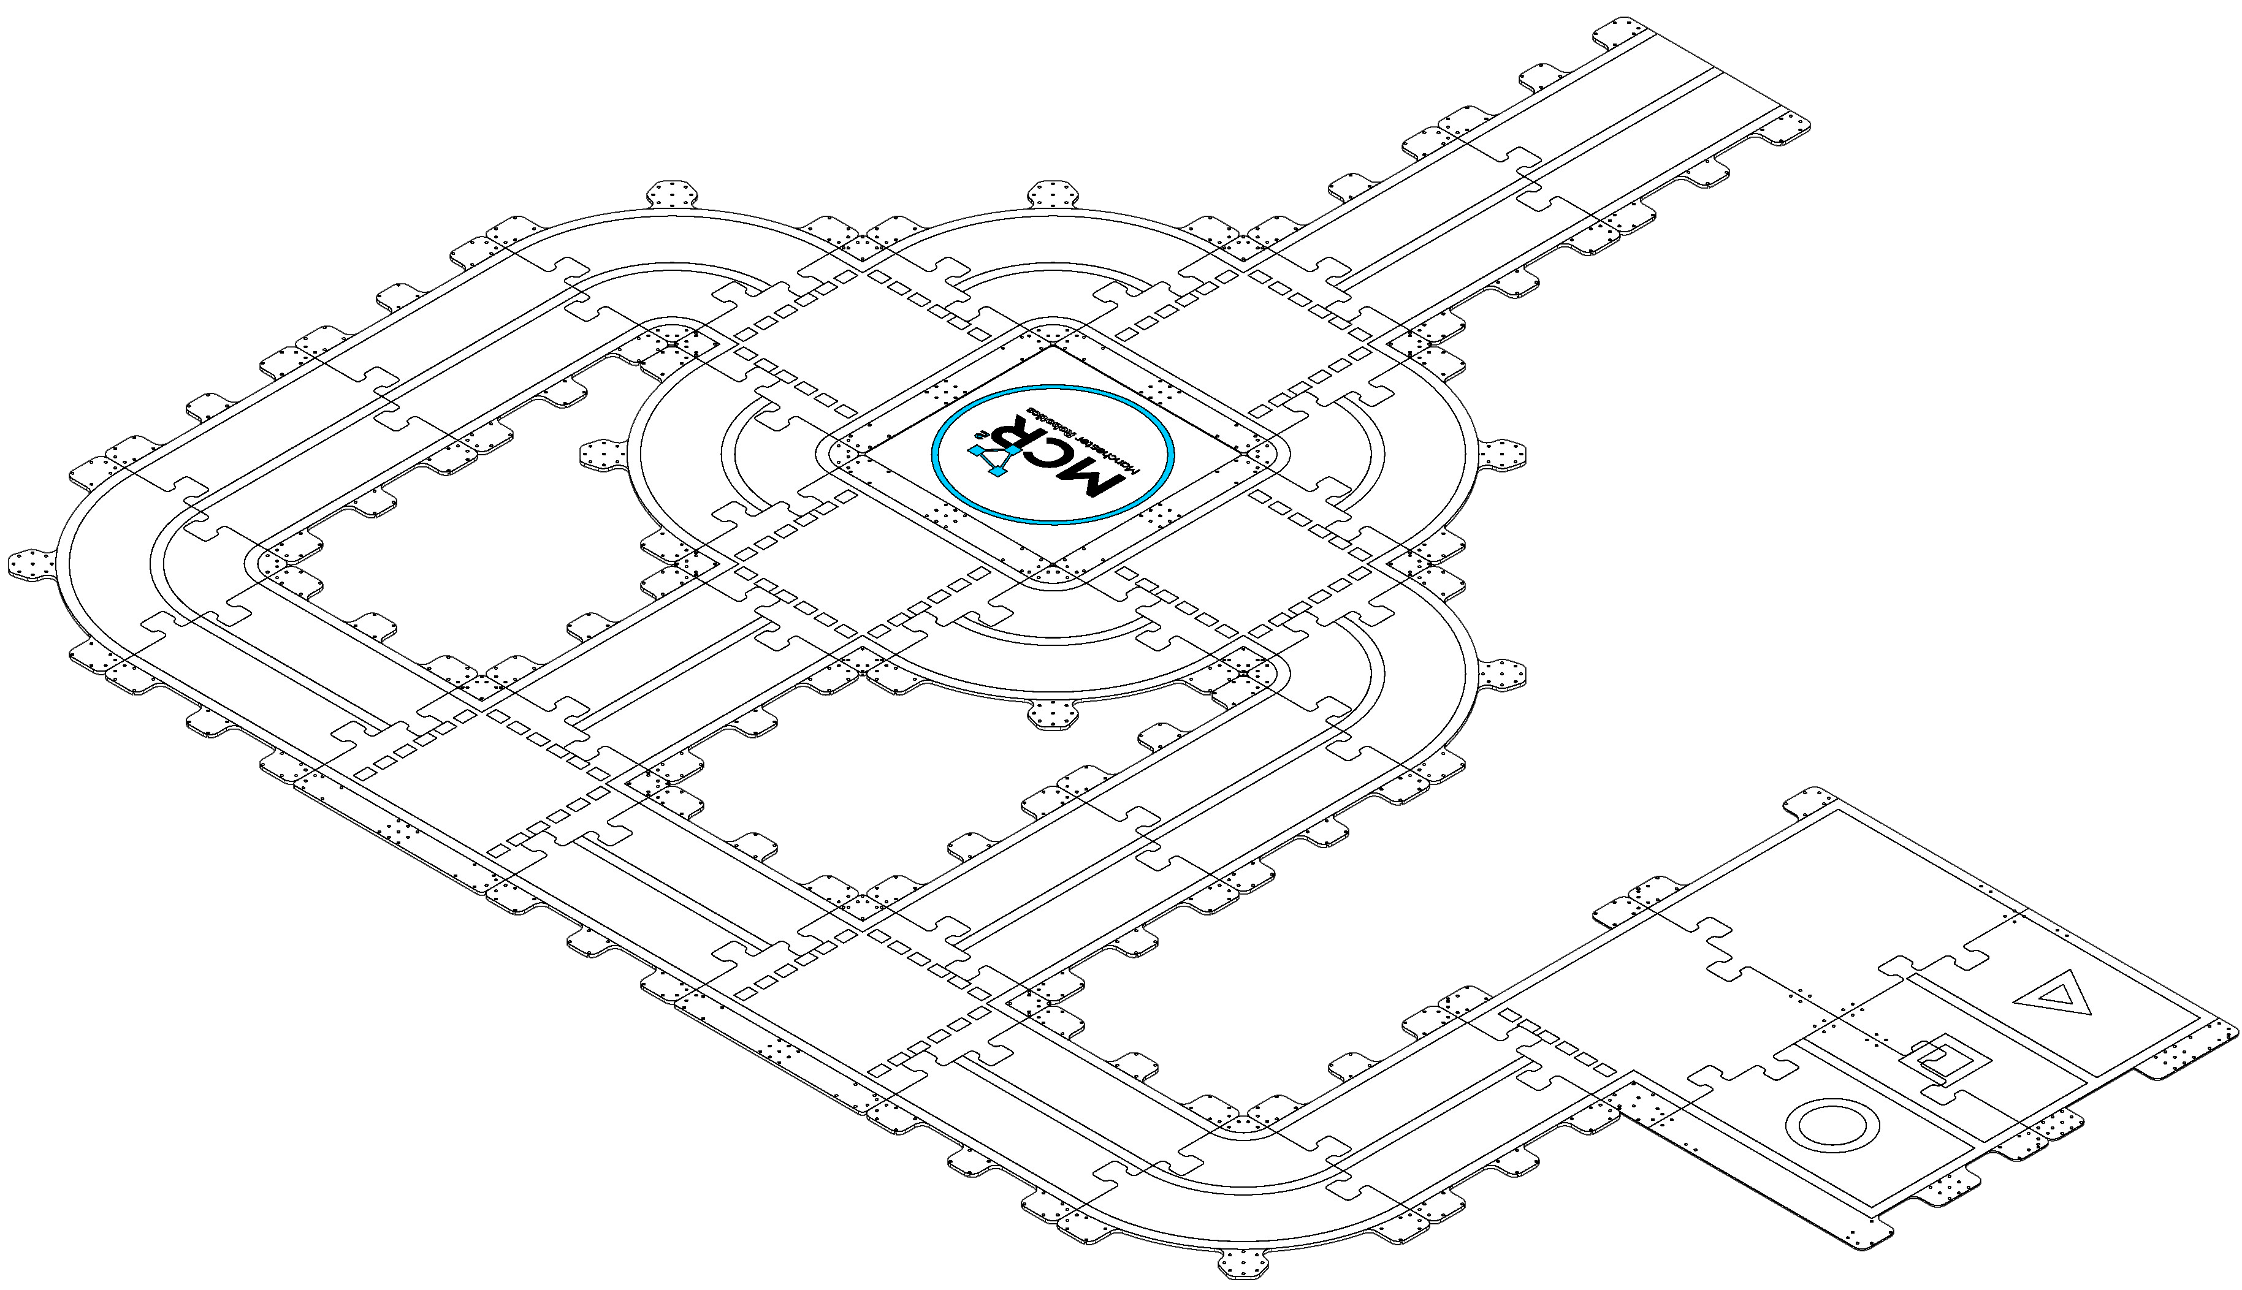
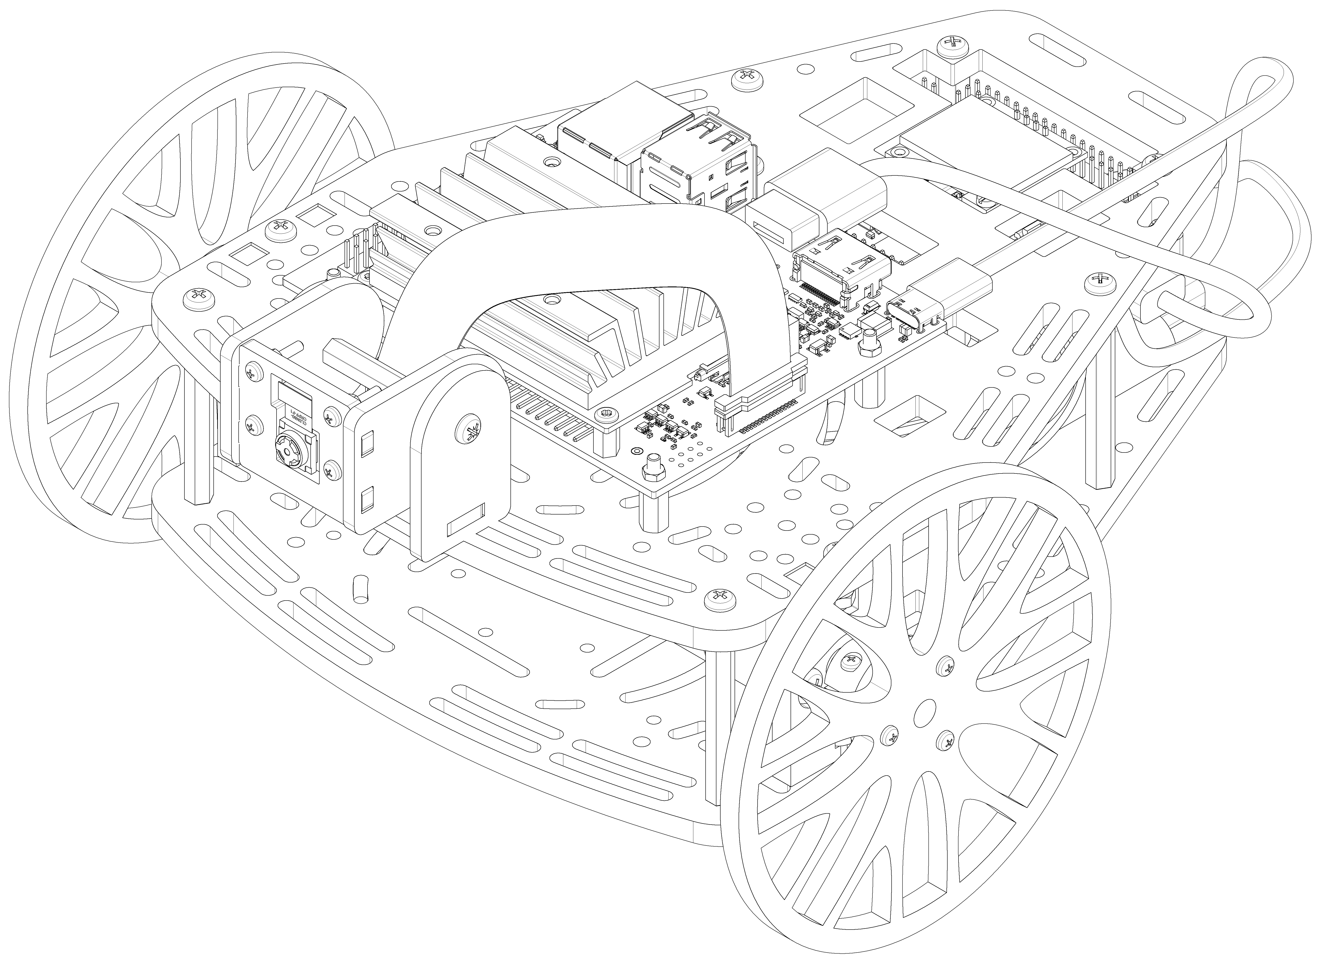

Final Challenge
Introduction
The challenge consists of autonomously driving the Puzzlebot on a predefined track.
The track consists of different MDF pieces assembled to form a “b” shape.
The Puzzlebot must follow a pre-defined route while obeying the traffic signals and traffic lights to complete the track.

Slide 3
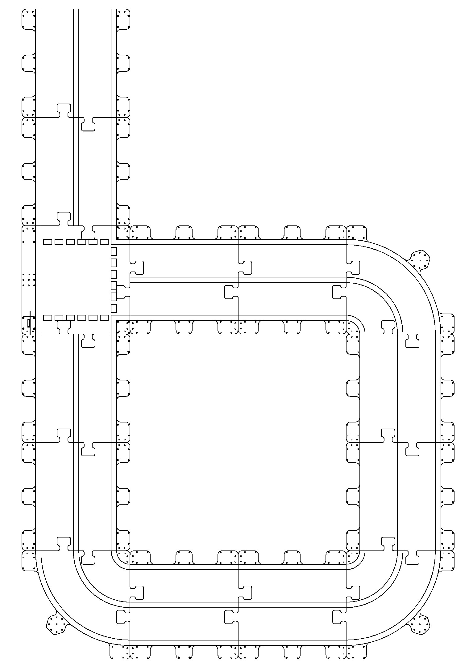

Final Challenge
Puzzletrack
The Puzzletrack is an MCR2 testing scenario for autonomous driving. It can transform and adapt to the needs of each activity.
The track uses actual traffic signs, traffic lights, and obstacles to resemble real-life scenarios for testing.
For this challenge, the Puzzletrack will be adapted to a “b” shaped form. The form is a dedication to the initial letter of the Spanish word “borregos salvajes”, which are official mascots of the Tec de Monterrey.

Slide 4
Final Challenge
Puzzletrack
The Puzzletrack is comprised of several “puzzle” pieces.
The pieces are designed to build different scenarios to test the Puzzlebot.
For this challenge three different pieces will be used, the straight lane piece, curve piece and intersection piece.
The pieces shown are for informative purposes only.
For more information about the Puzzletrack, contact us.
THE PIECES SHOWN HERE ARE FOR INFORMATIVE PURPOSES ONLY, THE DESIGN IS PROPRIETARY AND CONFIDENTIAL to MCR2. THE INFORMATION CONTAINED IN THIS DRAWING IS THE SOLE PROPERTY OF MANCHESTER ROBOTICS LTD. ANY REPRODUCTION IN PART OR AS A WHOLE WITHOUT THE WRITTEN PERMISSION OF MANCHESTER ROBOTICS LTD. IS PROHIBITED

Slide 5
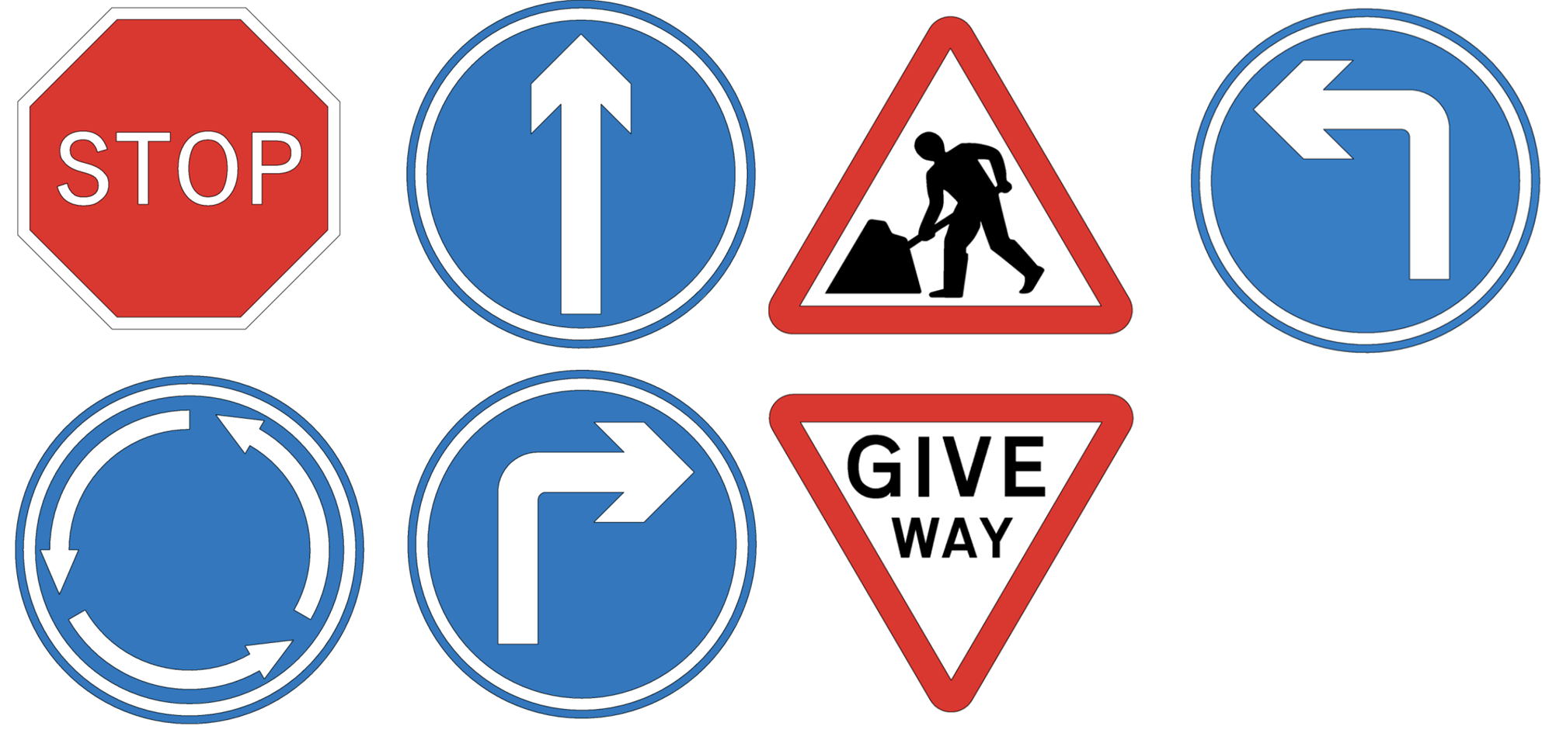
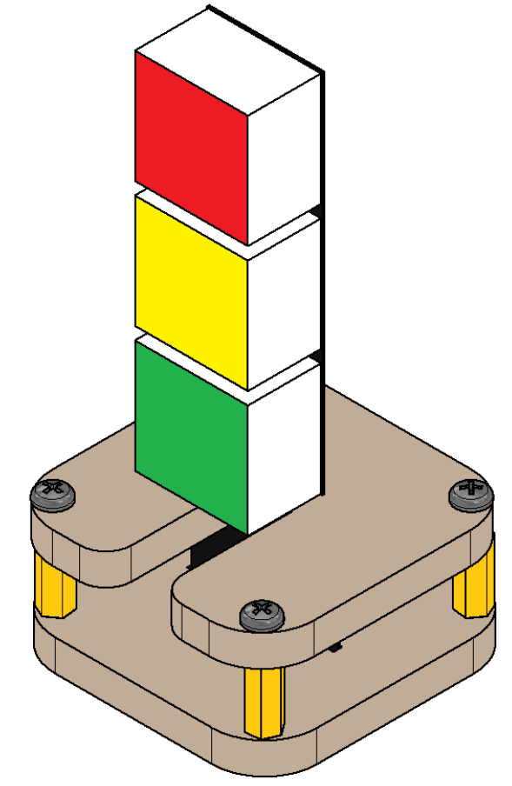

Final Challenge
Challenge
The student must complete the track in a trajectory defined by the traffic signs and lights.
The robot must autonomously recognise the traffic signs shown in this slide. The recognition must be made using vision systems and ML (optional).
The robot must autonomously recognise the traffic lights on the Puzzletrack. The recognition must be made using vision systems and ML (optional).
The final track will be given to the students two days before the deadline.

Slide 6

Final Challenge
Traffic Lights
The robot must automatically detect and obey the traffic lights according to the following behaviour.
Red: Stop until you see a green light.
Yellow: Drive slowly until you see a Red Light to stop.
Green: Continue with your Path.

Slide 7
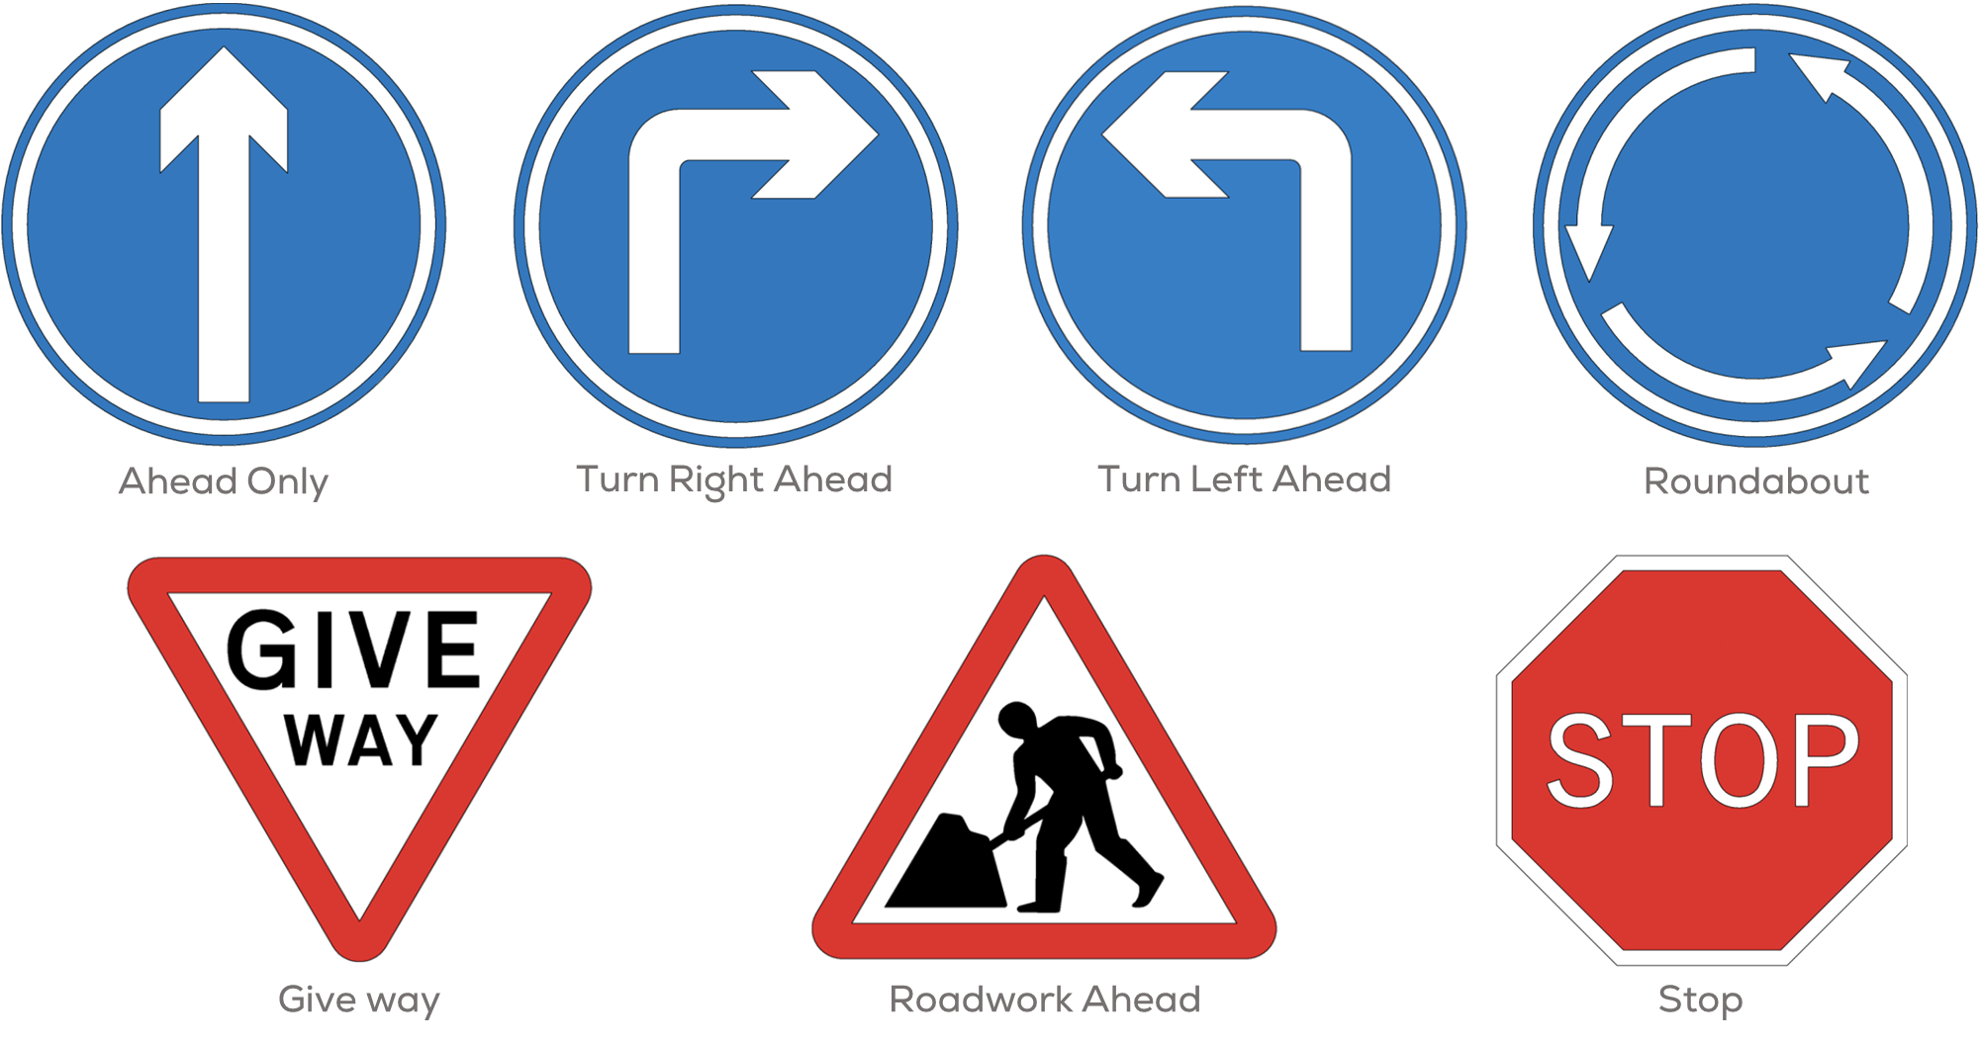
Final Challenge
Traffic Signs
The robot must automatically detect and obey the traffic signs according to the following behaviour (based on the UK highway code).
Ahead Only: Continue ahead only direction.
Turn Right/Left Ahead: Turn Left or right ahead.
Roundabout: Roundabout circulation. Slow speed and give way to vehicles from the immediate roundabout direction (left or right).
Roadwork Ahead: Reduce the speed of the robot.
Stop: Stop the robot.
Give way: Give way to traffic on major roads. Reduce the speed until you reach the intersection and give way.

Slide 8
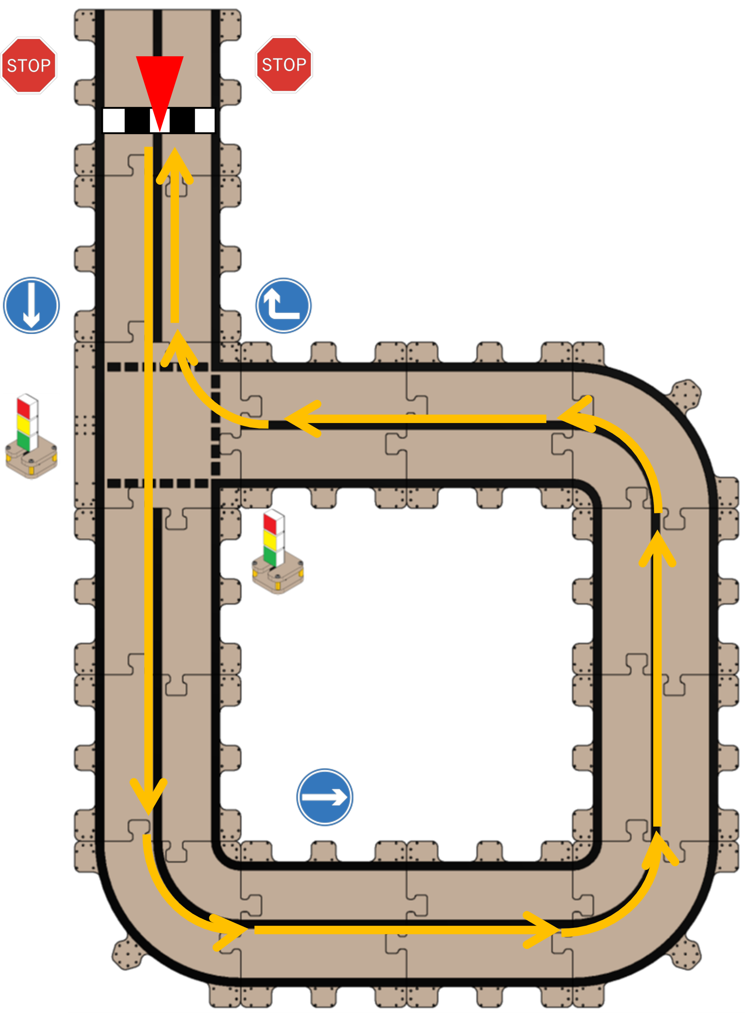
Final Challenge
Example Trajectory (Not the Challenge)
The robot must start at the top left corner, centred on the middle black line.
The robot must travel straight following the lane and remain centred on the middle line.
The robot crosses the intersection as stated by the traffic sign and when the traffic light allows it (turns green).
The robot must continue following the trajectory, as shown in Figure 2. Keeping the robot centred on the black line and always obeying the traffic signs.
The robot must cross the intersection a second time (as shown in the figure) and continue as stated by the traffic sign and when the traffic light allows it (turn green).
The robot must stop at a “reasonable” distance from the Stop sign.

Slide 9
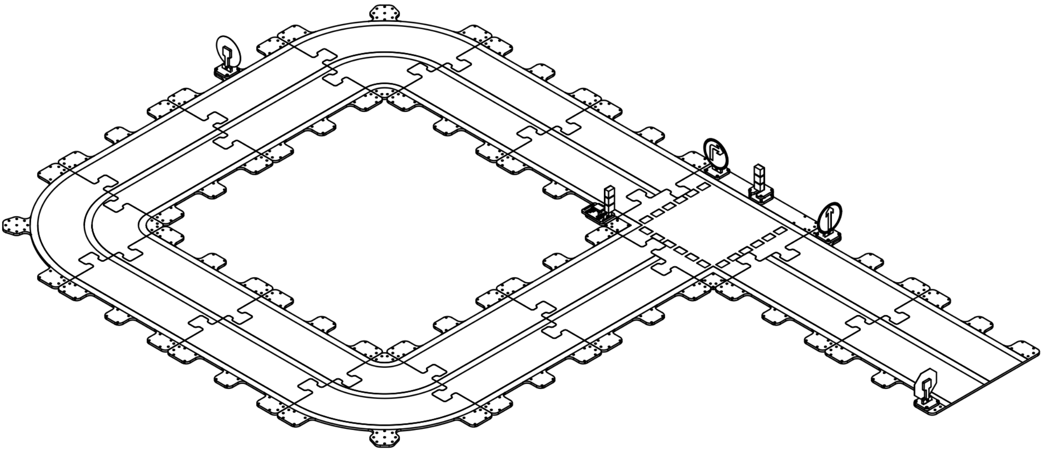
Track
Turn Right Sign
Ahead Only Sign
Traffic Lights

Slide 10
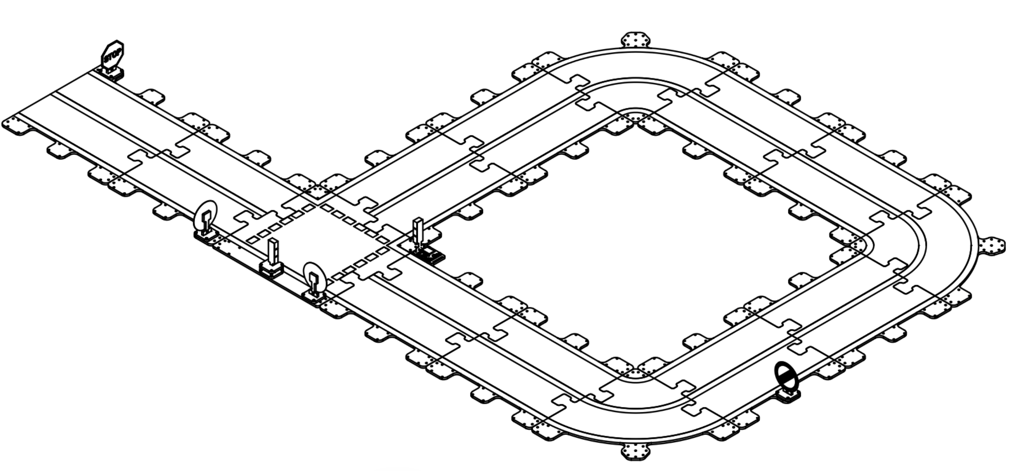
Track
Stop Sign
Traffic Lights

Slide 11
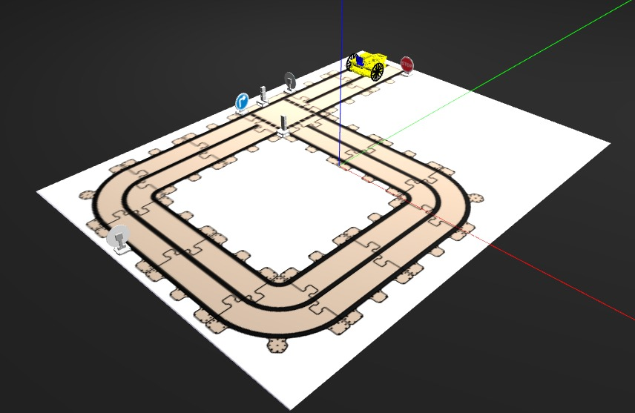
Final Challenge
Gazebo Simulator
As a helpful resource for students, a Gazebo Simulator is provided to test algorithms before real track testing.
The simulator is available on GitHub
The simulator includes the track, Puzzlebot, a camera, traffic lights, and traffic signs
Instructions for use are also provided on the GitHub page.

Slide 12
Deliverables
Each team must deliver a 3-4 min. Video where you explain your algorithms and how your team solved the challenge.
The video must be in English.
The video must contain diagrams showing the workflow of your algorithms.
The video must explain the challenges faced, solutions, comparisons, etc.
The teams must be prepared for a 2-minute Q&A session with MCR2.
The teams must submit their video via YouTube and share the link.
The professor at each campus will select the best two teams of each campus.
MCR2 will select the three finalists to present to a panel of judges and decide the winners.
Criteria
Completion of the challenge
Workflow diagrams, challenges faced, solutions, and comparisons.
Clear and concise theoretical and practical explanations
Presentation
The finalists must be prepared for a 3 min Q&A session with the judges.
Each professor at each campus will define the grading system.
Record each of your tests and final results to show your progress.

Slide 13
Deadlines
Final Presentation: 15 June 2023, 1 PM (Central Mexico Time)
Video Submission Deadline: 14 June 2023, 4 PM (Central Mexico Time)
Final Track Publication: 8 June 2023, 1 PM (Central Mexico Time)

Slide 14
Rules
General
This is a challenge, not a class. The students are encouraged to research, improve tune explain their algorithms by themselves.
All teams must abide by the rules set at each campus when using the track.
All the students must respect each other and abide by the following rules.
Manchester Robotics reserves the right to provide any form of grading. Grading and grading methodology are done by the professor in charge of the unit.
This task will be graded according to the rules established by the professors of each campus.
Feedback
MCR2(Manchester Robotics) Reserves the right to answer a question if it is determined that the query contains a partial or an answer.
The students are welcome to ask only about the theoretical aspect of the class.
The professors at each campus are encouraged to serve only as guides for the students, not revealing in any form a partial or total answer to the question.
Race
No remote control or other form of human interaction with the robot is allowed; except at the start/end of the track (put the robot on the track at the start and remove it afterwards).
The robot must always follow the black middle line (except at the intersection).
The robot must remain bound inside the lane (between right and left black lines).
The robot must obey all the Traffic signs and Traffic Lights.
No other trajectory or changes in the course are allowed.
Hardware/Software
The track can be solved using any knowledge acquired during the course.
The students must only use the hardware given by Manchester Robotics.
It is forbidden to use any other internet libraries except standard libraries such as NumPy.
If in doubt about libraries, please ask any teaching assistant.
Improvements to the algorithms are encouraged and may be used if the students provide the reasons and a detailed explanation of the improvements.

